Slide 1

Faculty of Information Technology, Monash University

Slide 2
FIT2004: Algorithms and Data Structures
Week 11: Topological Sort and Network Flow
These slides are prepared by M. A. Cheema and are based on the material developed by Arun Konagurthu and Lloyd Allison.

Slide 3
Announcements
How to find all MSTs?
http://www.mate.unlp.edu.ar/~liliana/lawclique_2016/07.pdf (thanks to the person who posted it on the forum)
Programming Competition round 2 closes on Monday 21-May-2018 23:59:00
Medal and Certificates to be given next week
SETU Feedback
Closes 3rd June – do it before it closes
To get a more detailed feedback, an Informal SETU will be conducted after the exams – stay tuned
Real-time anonymous feedback
https://goo.gl/forms/YPuiJMe1YtkGNDUH2
Link can also be found at Moodle (near the top)
Start preparing for the final exam

Slide 4
Outline
Topological Sort
Maximum Flow Problem
Ford-Fulkerson Algorithm
Min-cut Max-flow Theorem

Slide 5
Directed Acyclic Graph (DAG)
A Directed Acyclic Graph (DAG) is
Directed
Acylcic – has no cycles
Graph
Which of the two graphs is a DAG?
B
D
B
D
A
A
C
E
C
E
Graph 1
Graph 2

Slide 6
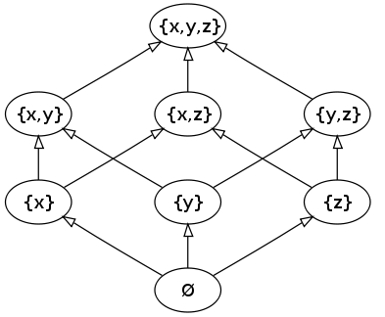
DAG: Examples
sub-tasks of a project and which “must finish before”
A → B means task A must finish before task B
so, DAGs useful in project management
relationships between subjects for your degree -- “is prerequisite for”
A→B means subject A must be completed before enrolling in subject B
people genealogy – “is an ancestor of”
A → B means A is an ancestor of B
power sets and “is a subset of“
A → B means A is a subset of B
B
D
A
C
E
Source: wikipedia

Slide 7
Topological Sort of a DAG
Partial order of vertices in a DAG
A < B if A→B.
Note that if A → B and B→D, we have A < B and B < D which implies that A < D (i.e., transitivity).
Some vertices may be incomparable (e.g., B and C are incomparable), i.e. A< B and A < C but we do not know whether C < B or B < C.
A topological Sort
is a permutation of the vertices in the original DAG
such that for every directed edge u→v of the DAG
u appears before v in the permutation
Example: A, B, C, E, D
Topological sort of a DAG of “is prerequisite of” example gives an ordering of the subjects for studying your degree, one at a time, while obeying prerequisite rules.
B
D
A
C
E

Slide 8

Topological Sort of a DAG
A DAG can have many valid topological sorts, e.g., let u and v be two incomparable vertices, u may appear before or after v.
Which of these is NOT a valid topological sort of the DAG
A, B, C, E, D
A, C, B, E, D
A, C, E, B, D
A, B, E, C, D
How to do topological sort?
Kahn’s Algorithm
B
D
A
C
E

Slide 9
Kahn’s Algorithm
initialize Sorted to be empty # Sorted will contain the topological sort
initialize a list L with vertices that do not have any incoming edge
while L is not empty:
remove any vertex v from L
Sorted = Sorted + {v}
for each outgoing edge v → u of v:
remove edge v → u from the graph
if u has no other incoming edge:
insert u in L # all the vertices that must appear before u have already been added to Sorted
if graph still has some edges:
return error # graph has a cycle
else:
return Sorted
?
Time Complexity?
?
B
D
A
C
E
L:
A
B
E
C
D
Sorted:
A
B
C
E
D

Slide 10
Kahn’s Algorithm: Complexity
initialize Sorted to be empty # Sorted will contain the topological sort
initialize an array IncomingEdges[] of size V with all values set to 0
for each edge u → v in E:
IncomingEdge[v] += 1
initialize a list L containing vertices for which IncomingEdges[v] = 0
while L is not empty:
remove any vertex v from L
Sorted = Sorted + {v}
for each outgoing edge v → u of v:
remove edge v → u from the graph
IncomingEdges[u] = IncomingEdges[u] - 1
if IncomingEdges[u] == 0: # u has no incoming edge
insert u in L
if graph still has some edges:
return error # graph has a cycle
else:
return Sorted
O(E+V)
O(E+V)
B
D
A
Time Complexity: O(V+E)
Space Complexity: O(V+E)
C
E

Slide 11
Outline
Topological Sort
Maximum Flow Problem
Ford-Fulkerson Algorithm
Min-cut Max-flow Theorem

Slide 12
Flow Networks
A flow network is a connected directed graph where
there is a single source vertex and a single sink/destination vertex;
each edge has a given (non-negative) capacity (usually integers)
giving the maximum amount/rate of flow that the edge can carry;
Flow networks model many real-world problems
Water flowing through an assembly of pipes.
Electric current flowing through electrical circuits.
Information flowing through communication networks
Can be applied to many scenarios (unrelated to physical flows).
12
16
a
c
20
s
4
9
7
t
10
13
4
b
d
14

Slide 13
Some basic notations
Set of all incoming edges to a vertex v: denoted as E_{in}(v)
E_{in}(b) = s → b, c → b, a → b
E_{in}(a) = ?
Set of all outgoing edges from a vertex v: denoted as E_{out}(v)
E_{out}(b) = b → a, b → d
E_{out}(a) = ?
Source Vertex: denoted as s (has no incoming edges)
Sink/target vertex: denoted as t (has no outgoing edges)
12
16
a
c
20
s
4
9
7
t
10
13
4
b
d
14

Slide 14
Flow
Flow is an assignment of how much material is flowing through each edge in the flow network given its stated edge capacity.
All vertices (except source and sink) conserve their flow. That is
The total amount flowing into any vertex (through incoming edges)
IS EQUAL TO
the total amount flowing out of that vertex (through outgoing edges).
I.e., Total incoming flow at a vertex = total outgoing flow at a vertex
This key property is called flow conservation.
12/12
11/16
a
c
15/20
s
10
1/4
7/7
t
4/9
8/13
4/4
b
d
11/14
Green numbers indicate flow and red indicate capacity. Flow is not shown if 0

Slide 15

Properties of a Flow Network
A flow network must satisfy the following two properties.
Property 1: Capacity Constraint
For each edge e, its flow, denoted as f(e), is bounded by the capacity of its edge, i.e., 0 ≤ f(e) ≤ c(e) where c(e) is the capacity of the edge
Property 2: Flow Conservation
For any vertex v (except source and sink), the total flow coming into the vertex must be equal to the total flow going out from this vertex – formally
What is total outgoing flow of b?
What is total incoming flow of b?
12/12
11/16
a
c
15/20
s
1/4
7/7
t
10
4/9
8/13
4/4
b
d
11/14
Green numbers indicate flow and red indicate capacity. Flow is not shown if 0

Slide 16
Maximum-flow Problem
Value of a flow in a network:
Given that flow network satisfies the capacity constraint and flow conservation properties, flow of a network is the total flow out of the source vertex. Equivalently, this is the same as the total flow into sink vertex.
What is the flow value in the flow network at bottom right?
What is the flow value in the flow network at bottom left?
Maximum-flow problem
Given a flow network, what is the maximum value of the flow that can be sent from source s to sink t without violating the flow network properties.
12/12
12/12
11/16
a
c
15/20
11/16
a
c
19/20
s
1/4
7/7
t
s
1/4
7/7
t
10
4/9
10
9
8/13
4/4
12/13
4/4
b
d
b
d
11/14
11/14
Green numbers indicate flow and red indicate capacity. Flow is not shown if 0

Slide 17

Outline
Topological Sort
Maximum Flow Problem
Ford-Fulkerson Algorithm
Min-cut Max-flow Theorem

Slide 18
Residual Network
Residual network has the same vertices as the original network.
For every directed edge u→v in flow network, we add two edges in the residual network:
Forward edge/Residual edge: An edge in the same direction as u→v with the residual/remaining capacity
Indicates the remaining capacity (remaining amount of flow) that can be sent via the edge u→v
Edge is not created if remaining capacity is 0.
Backward edge/Reversible flow edge: An edge in the direction opposite to u→v (i.e., v→u) with weight equal to the current flow of u→v in the flow network
Indicates the flow that can be reversed/cancelled
Edge is not created if reversible flow is 0
Edges in the same direction are merged into a single edge with total weight shown
MARS: Weight of ?
12/12
12
11/16
a
c
15/20
5
a
c
5
11
1/4
t
3
4
15
t
s
10
4/9
7/7
s
11
7
5
5
8/13
4/4
8
3
4
b
d
b
d
11/14
11
Flow Network: Green numbers indicate flow and red indicate capacity. Flow is not shown if 0
Residual Network: Where possible blue edges indicate reversible flow and red indicate residual capacity

Slide 19
Augmenting Path in Residual Network
Augmenting path is any simple path (a path without repeating vertices) from source s to target t.
E.g., s → b → c → t (shown in purple edges)
Residual capacity of a path is the minimum edge weight on this path (e.g., 4 in the example)
For each edge along this path, we can push additional flow equal to the “residual capacity of the path” in the flow network, e.g., 4 along each edge on s → b → c →t
12/12
12
a
c
19/20
a
c
5
11/16
15/20
5
11
1/4
t
3
4
15
t
s
10
0/9
7/7
s
11
7
4/9
5
5
12/13
8/13
4/4
8
3
4
b
d
b
d
11/14
11
Flow Network: Green numbers indicate flow and red indicate capacity. Flow is not shown if 0
Residual Network: Where possible blue edges indicate reversible flow and red indicate residual capacity

Slide 20
Ford-Fulkerson Method
Initialize flow f to zero
Create residual network
While there exists an augmenting path in the residual network:
choose any augmenting path P
augment the flow equal to residual capacity of P in the flow network
update residual network
return f
4/
12
12
16
a
c
4/
20
16
a
c
20
s
4
7
t
s
4
t
10
4/
7
9
10
9
13
4/
13
b
d
4
b
d
4
14
4/
14
Flow Network: Green numbers indicate flow and red indicate capacity. Flow is not shown if 0
f = 4
Residual Network: Where possible blue edges indicate reversible flow and red indicate residual capacity
f = 0

Slide 21
Ford-Fulkerson Method
Initialize flow f to zero
Create residual network
While there exists an augmenting path P in the residual network:
choose any augmenting path P
augment the flow equal to residual capacity of P in the flow network
update residual network
return f
4/
8
12
16
a
c
4/
a
c
11/
7/
20
12
20
4
10
t
4
t
s
7/
4
7
5
4/
7/
s
4
7
9
10
4
13
4/
13
10
4
b
d
4
b
d
11/
14
4/
4
Flow Network: Green numbers indicate flow and red indicate capacity. Flow is not shown if 0
f = 4
Residual Network: Where possible blue edges indicate reversible flow and red indicate residual capacity
f = 11

Slide 22
Ford-Fulkerson Method
Initialize flow f to zero
Create residual network
While there exists an augmenting path P in the residual network:
choose any augmenting path P
augment the flow equal to residual capacity of P in the flow network
update residual network
return f
4/
8
12
9/
11/
16
a
c
a
c
16/
12/
7/
20
5
13
4
10
t
11
7
t
s
7/
4
7
5
4/
7/
s
11
7
9
3
4
13
4/
13
3
4
b
d
4
b
d
11/
14
11
Flow Network: Green numbers indicate flow and red indicate capacity. Flow is not shown if 0
f = 16
Residual Network: Where possible blue edges indicate reversible flow and red indicate residual capacity
f = 11

Slide 23
Ford-Fulkerson Method
Initialize flow f to zero
Create residual network
While there exists an augmenting path P in the residual network:
choose any augmenting path P
augment the flow equal to residual capacity of P in the flow network
update residual network
return f
9/
3
12
16/
16
a
c
12/
20
a
c
16/
8
9
16
12
10
t
t
s
7/
4
7
5
0/
7/
s
11
7
4/
9
3
4
13
4/
4/
13
3
4
b
d
4
b
d
11/
14
11
Flow Network: Green numbers indicate flow and red indicate capacity. Flow is not shown if 0
f = 16
Residual Network: Where possible blue edges indicate reversible flow and red indicate residual capacity
f = 20

Slide 24
Ford-Fulkerson Method
Initialize flow f to zero
Create residual network
While there exists an augmenting path P in the residual network:
choose any augmenting path P
augment the flow equal to residual capacity of P in the flow network
update residual network
return f
9/
3
12
12/
16/
16
a
c
16/
20
a
c
19/
4
9
16
16
10
t
t
7/
3/
9
s
4
7
0/
7/
s
11
7
9
3
9
7/
13
4/
4/
3
4
b
d
4
4
b
d
11/
14
11
Flow Network: Green numbers indicate flow and red indicate capacity. Flow is not shown if 0
f = 23
Residual Network: Where possible blue edges indicate reversible flow and red indicate residual capacity
f = 20

Slide 25
Ford-Fulkerson Method
Initialize flow f to zero
Create residual network
While there exists an augmenting path P in the residual network:
choose any augmenting path P
augment the flow equal to residual capacity of P in the flow network
update residual network
return f
12/
12
16/
16
a
c
19/
20
a
c
1
12
16
19
10
t
t
7/
3/
9
s
4
7
0/
7/
s
8
7
9
6
6
13
7/
4/
3
4
b
d
4
7
b
d
11/
14
11
Flow Network: Green numbers indicate flow and red indicate capacity. Flow is not shown if 0
f = 23
Residual Network: Where possible blue edges indicate reversible flow and red indicate residual capacity

Slide 26
Complexity Analysis
Initialize flow f to zero
Create residual network
While there exists an augmenting path P in the residual network:
choose any augmenting path P
augment the flow equal to residual capacity of P in the flow network
update residual network
return f
Number of edges in residual network
At most 2E → O(E)
Total cost for a single iteration of the while loop?
Cost of finding an augmenting path?
O(V+E) assuming we are using BFS to find the path (assuming all edges are unweighted)
Cost of augmenting the flow in network
O(V+E) – there are at most V-1 edges in a path; finding/updating these edges in adjacency lists takes at most O(V+E)
Cost of updating residual network
O(V+E) – same as above
Total Cost for a single iteration: O(V+E) or O(E) because the graph is connected and O(E) ≥ O(V)
Let F be the maximum flow of the network. What is the maximum number of iterations assuming all edge weights are integers?
O(F).
Total cost of the algorithm assuming integer capacities: O(EF)
NON EXAMINABLE
The above time complexity is pseudo-polynomial because F is an integer which can be arbitrarily large.
It can be proved that the complexity is O(VE²) when BFS is used for finding augmenting path. This complexity is polynomial.

Slide 27

Proof of Correctness
Does the algorithm terminate?
Yes, because
the flow always increases by at least 1 and the algorithm terminates when flow is equal to the maximum flow
When the algorithm terminates (i.e., there is no augmenting path in residual network), the flow of the network is the maximum flow.
We will need to understand “min-cut and max-flow” theorem

Slide 28
Outline
Topological Sort
Maximum Flow Problem
Ford-Fulkerson Algorithm
Min-cut Max-flow Theorem

Slide 29
Flow and capacity of a cut
A cut (S,T) of a flow network partitions the vertices of the network into two disjoint partitions S and T such that source s is in S and target t is in T.
E.g., S = {s,a,b} and T = {t, c, d}
Cut-set of a cut (S,T) is the set of edges that “cross” the cut, i.e., each edge connects one vertex in S with another in T.
E.g., the cut-set for the example is a→c, b→d, c→b (green edges)
The edges that have direction from a vertex in S to a vertex in T are called outgoing edges of the cut.
E.g., a→c and b→d are the outgoing edges of the cut
The edges that have direction from a vertex in T to a vertex in S are called incoming edges of the cut.
E.g., c→b is an incoming edge of the cut.
Capacity of a cut (S,T) is the total capacity of its outgoing edges
E.g., capacity of the cut in the example is 12 + 14 = 26
Flow of a cut (S,T) is
Total flow of its outgoing edges – total flow of its incoming edges
E.g., flow in the example is 12 + 11 – 4 = 19
12/12
11/16
a
c
15/20
Is it true that flow of a cut is always less than or equal to the capacity of the cut?
Yes, because
Flow of an edge ≤ capacity of an edge
Capacity of a cut does not subtract capacities for incoming edges
s
1/4
7/7
t
10
4/9
8/13
4/4
b
d
11/14

Slide 30
Flow and capacity of a cut
Capacity of a cut (S,T): the total capacity of its outgoing edges
Flow of a cut (S,T): Total flow of its outgoing edges – total flow of its incoming edges
Assume S = {s, a,b,c,d} and T = {t}.
What is the capacity of this cut?
What is the flow of this cut?
Assume S = {s, a, b,d} and T = {c,t}.
What is the capacity of this cut?
What is the flow of this cut?
Assume S = {s, a} and T = {b,c,d,t}.
What is the capacity of this cut?
What is the flow of this cut?
What is the flow value of this network?
Note: flow of all of the above cuts is 19
which is the same as flow of the network.
I.e., flow of every cut = flow of the network
Let’s prove this formally
12/12
11/16
a
c
15/20
s
1/4
7/7
t
10
4/9
8/13
4/4
b
d
11/14

Slide 31
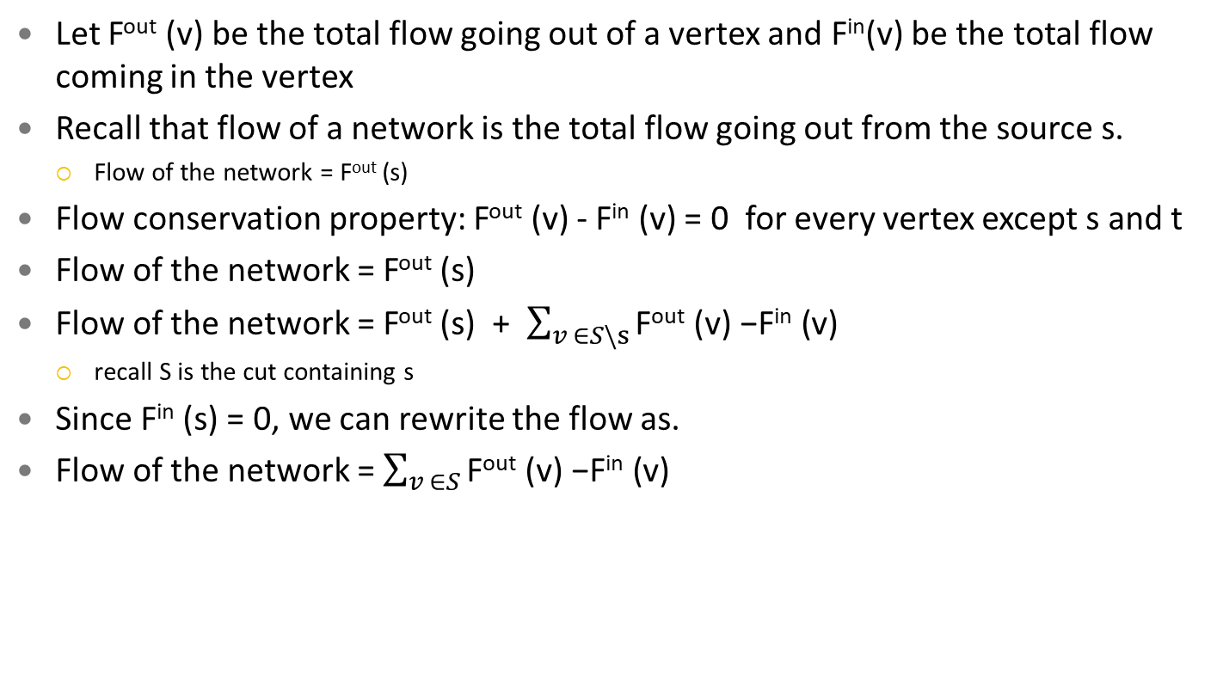
Flow of a cut = Flow of the network
Let F^{out} (v) be the total flow going out of a vertex and F^{in}(v) be the total flow coming in the vertex
Recall that flow of a network is the total flow going out from the source s.
Flow of the network = F^{out} (s)
Flow conservation property: F^{out} (v) - F^{in} (v) = 0 for every vertex except s and t
Flow of the network = F^{out} (s)
Flow of the network = F^{out} (s) + $\sum_{v ∈S\backslash s}{\text{F}\text{out}\text{ (}\text{v}\text{) −}\text{Fin}\text{ (}\text{v}\text{) }}$
recall S is the cut containing s
Since F^{in} (s) = 0, we can rewrite the flow as.
Flow of the network = $\sum_{v ∈S}{\text{F}\text{out}\text{ (}\text{v}\text{) −}\text{Fin}\text{ (}\text{v}\text{)}}$
12/12
11/16
a
c
15/20
s
1/4
7/7
t
10
4/9
8/13
4/4
b
d
11/14

Slide 32
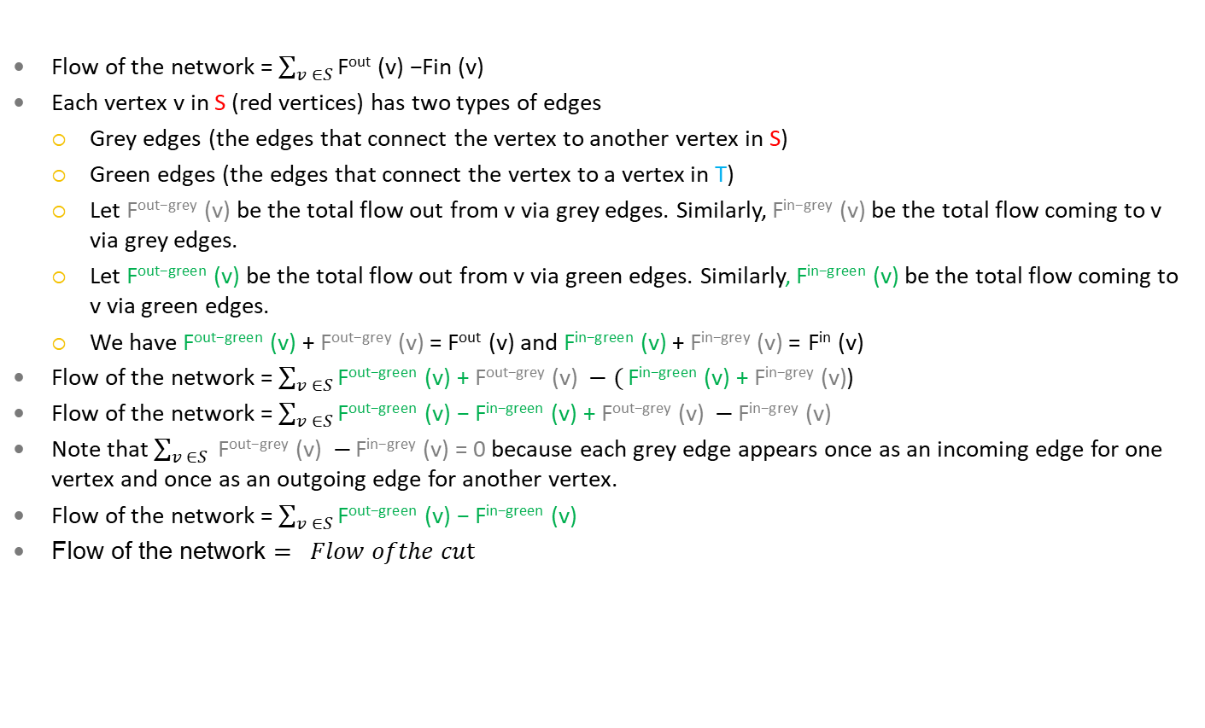
Flow of a cut = Flow of the network
Flow of the network = $\sum_{v ∈S}{\text{F}\text{out}\text{ (}\text{v}\text{) −}\text{Fin}\text{ (}\text{v}\text{)}}$
Each vertex v in S (red vertices) has two types of edges
Grey edges (the edges that connect the vertex to another vertex in S)
Green edges (the edges that connect the vertex to a vertex in T)
Let $\text{F}\text{out}\text{−}\text{grey}\text{ (}\text{v}\text{)}$ be the total flow out from v via grey edges. Similarly, $\text{F}\text{in}\text{−}\text{grey}\text{ (}\text{v}\text{)}$ be the total flow coming to v via grey edges.
Let $\text{F}\text{out}\text{−}\text{green}\text{ (}\text{v}\text{)}$ be the total flow out from v via green edges. Similarly, $\text{F}\text{in}\text{−}\text{green}\text{ (}\text{v}\text{)}$ be the total flow coming to v via green edges.
We have $\text{F}\text{out}\text{−}\text{green}\text{ (}\text{v}\text{)}$ + $\text{F}\text{out}\text{−}\text{grey}\text{ (}\text{v}\text{)}$ = $\text{F}\text{out}\text{ (}\text{v}\text{)}$ and $\text{F}\text{in}\text{−}\text{green}\text{ (}\text{v}\text{)}$ + $\text{F}\text{in}\text{−}\text{grey}\text{ (}\text{v}\text{)}$ = $\text{F}\text{in}\text{ (}\text{v}\text{)}$
Flow of the network = $\sum_{v ∈S}{\text{F}\text{out}\text{−}\text{green}\text{ (}\text{v}\text{) + }\text{F}\text{out}\text{−}\text{grey}\text{ (}\text{v}\text{)} −(}\text{F}\text{in}\text{−}\text{green}\text{ (}\text{v}\text{) + }\text{F}\text{in}\text{−}\text{grey}\text{ (}\text{v}\text{)}$)
Flow of the network = $\sum_{v ∈S}{\text{F}\text{out}\text{−}\text{green}\text{ (}\text{v}\text{) − }\text{Fin}\text{−}\text{green}\text{ (}\text{v}\text{) + }\text{F}\text{out}\text{−}\text{grey}\text{ (}\text{v}\text{)} −}\text{F}\text{in}\text{−}\text{grey}\text{ (}\text{v}\text{)}$
Note that $\sum_{v ∈S}{ \text{F}\text{out}\text{−}\text{grey}\text{ (}\text{v}\text{)} −}\text{F}\text{in}\text{−}\text{grey}\text{ (}\text{v}\text{) = 0}$ because each grey edge appears once as an incoming edge for one vertex and once as an outgoing edge for another vertex.
Flow of the network = $\sum_{v ∈S}{\text{F}\text{out}\text{−}\text{green}\text{ (}\text{v}\text{) − }\text{Fin}\text{−}\text{green}\text{ (}\text{v}\text{) }}$
Flow of the network $= Flow ofthe cut$
12/12
11/16
a
c
15/20
s
1/4
7/7
t
10
4/9
8/13
4/4
b
d
11/14

Slide 33
Min-cut Max-Flow Theorem
Min-cut of a flow network is the cut with the minimum capacity
We know that
Flow of a cut ≤ capacity of the cut
Flow of every cut = Flow of the network
Therefore, Maximum possible flow of the network ≤ capacity of every cut
Or, Maximum possible flow of the network ≤ capacity of min-cut
What if we can find a cut such that the flow of the network = capacity of the cut
This would mean flow of the network is the maximum possible (we have found maximum possible flow)
The cut is the min-cut of the flow network
Min-cut Max-Flow Theorem
Maximum possible flow of a network = capacity of the min-cut
12/12
11/16
a
c
15/20
s
1/4
7/7
t
10
4/9
8/13
4/4
b
d
11/14

Slide 34
Min-cut Max-Flow Theorem
Capacity of a cut (S,T) is the total capacity of its outgoing edges
Flow of a cut (S,T) = Total flow of its outgoing edges – total flow of its incoming edges
Is it true that flow of a cut = capacity of the cut when:
Flow on each outgoing edge of the cut is equal to the capacity of the edge; AND
Flow on each incoming edge of the cut is zero
We show that when the algorithm terminates, there exists a cut for which both of the above two conditions hold which imply that the flow of the cut is equal to its capacity.
This guarantees that the flow is maximum
12/12
11/16
a
c
15/20
s
1/4
7/7
t
10
4/9
8/13
4/4
b
d
11/14

Slide 35
Proof of correctness
Suppose the algorithm has terminated (there does not exist any augmenting path in the residual network).
We define a cut (S,T) such that
S contains every vertex v that is reachable from s in the residual network.
T contains every other vertex. Note t cannot be in S because it is not reachable from S (no augmenting path)
Flow of this cut = Capacity of this cut because
For each outgoing edge a→c, its flow is equal to the capacity of the edge
Otherwise, we would have an edge a→c in the residual network which would mean c is reachable from s but we know this is not the case as c is not in S.
For each incoming edge c → b, its flow is zero.
Otherwise, there would be an edge b→c in the residual network implying c is reachable from s but we know this is not the case as c is not in S.
Therefore, the flow is maximum when the algorithm terminates
12/
12
16/
16
a
c
19/
20
a
c
1
16
12
10
t
19
t
7/
3/
9
s
4
7
6
0/
7/
s
8
7
9
6
13
7/
4/
3
4
b
d
4
7
b
d
11/
14
11
Flow Network: Green numbers indicate flow and red indicate capacity. Flow is not shown if 0
f = 23
Residual Network:

Slide 36
Summary
Take home message
Topological sort gives an ordering in which to complete the tasks given constraints
Maximum flow of a network is equal to its min-cut and can be found using Ford-Fulkerson
Things to do (this list is not exhaustive)
Make sure you understand
the two algorithms
understand why Ford-Fulkerson is correct
Start preparing for the final exam
Coming Up Next
More on network flow and final exam

